Slide 1
Prudential Life Insurance Assessment Using R
Group 10
Rui Shen
Gayathri Maganti
Kamala Nayana Uppalapati

Slide 2

Purpose
Understand data preprocessing steps
Understand three analysis techniques
Understand the difference between classification and regression techniques

Slide 3
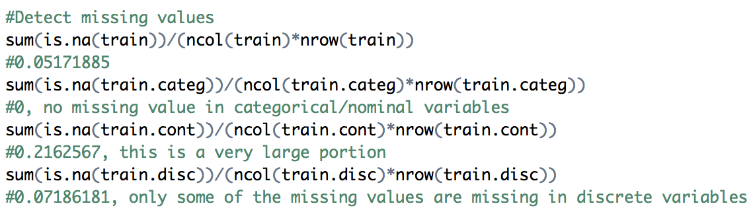
Data Pre-processing
1. Look into our data:
Where are the missing values?
How to fill in missing values?
– mean, median, mice

Slide 4
Data Pre-processing
2. Data transformation and
Dimension reduction
Factor columns:
Product_Info_2
Abnormal categorical columns:
"Column Product_Info_3 has 34 levels"
"Column Employment_Info_2 has 36 levels"
"Column InsuredInfo_3 has 11 levels"
"Column Medical_History_2 has 579 levels"

Slide 5

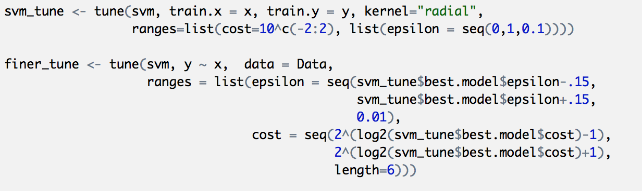
SVM Analysis
What is SVM?
Basic steps
Build svm model
Tune the model by changing parameters
Build the svm model using best param

Slide 6
SVM Analysis
Built 8 svm models
Final svm model:

Slide 7
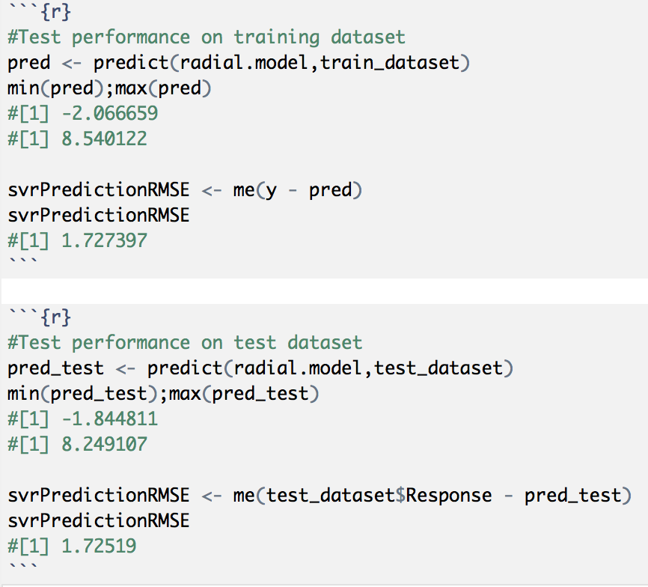
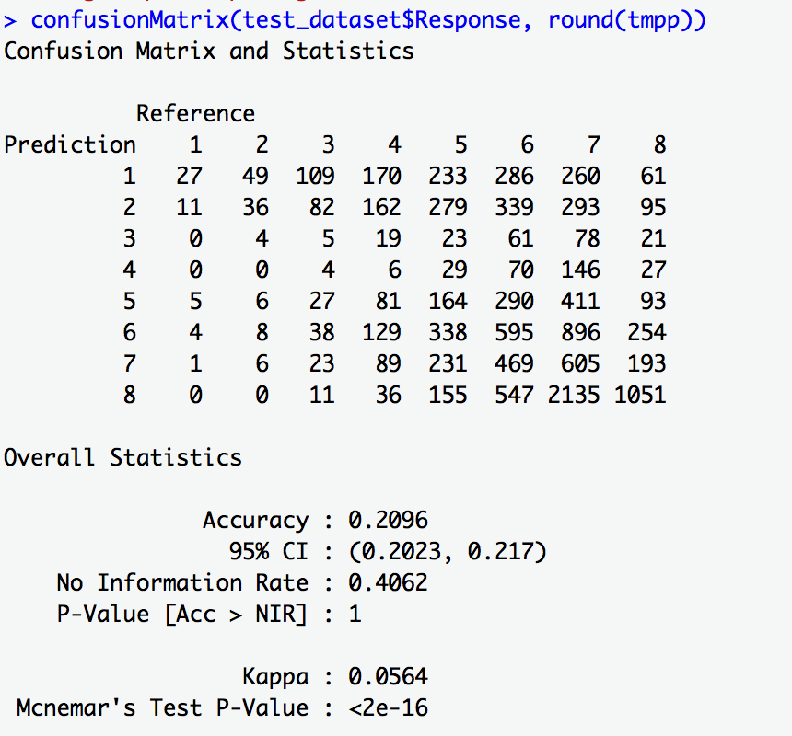
SVM Analysis
Prediction using the final model

Slide 8
Multiple Linear Regression is the most common form of linear regression analysis. As a predictive analysis, the multiple linear regression is used to explain the relationship between one continuous dependent variable from two or more independent variables The independent variables can be 1. continuous 2. categorical Steps involved during building the multiple linear regression model for the prudential life insurance dataset were: 1.) Splitting the cleaned dataset into 80% train data and 20% validation data. 2.) Build the first regression model taking all the columns into consideration and checking R-squared, adjusted R-squared values and p-values. 3.) Reducing Dimension using p-value where p-value is less than 0.05. 4.) During this step the variables (columns) having less or no significance in the model on observing their significant codes are eliminated. 5.) The final linear regression model was selected after the R-squared and adjusted R-squared values started to decrease after eliminating more columns that were later restored. 6.) The final model was used to predict the Response variable for the test dataset predicting values anywhere between 1 to 8. 7.) The predicted output and the actual output was then used to get the mean squared error by applying MSE formula.
Multiple Linear Regression

Slide 9
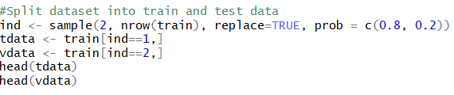
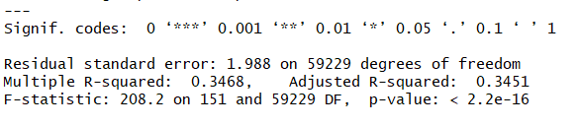
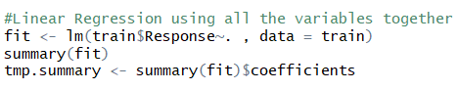
Code & Summary
Code Snippets & Regression Model
Code Snippet: Data Splitting
First Model Summary:
First Model with all Columns:

Slide 10
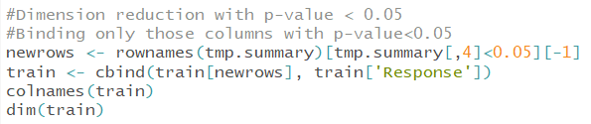
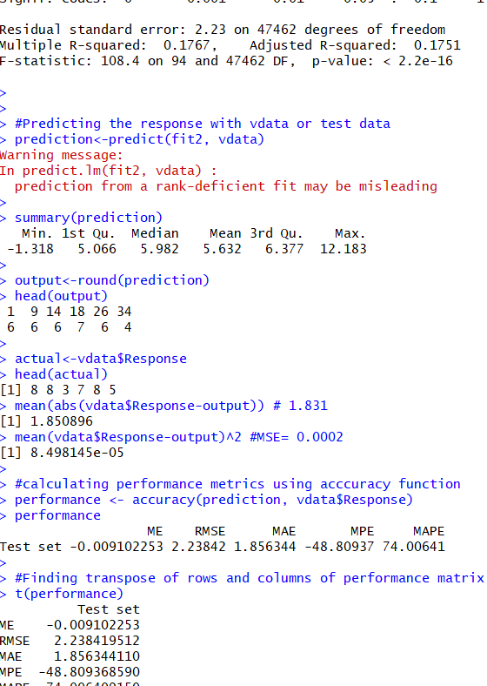
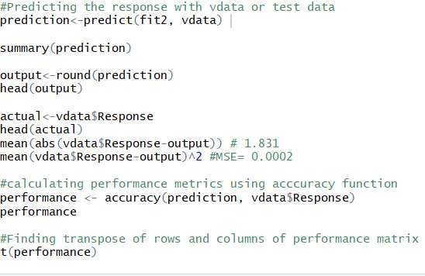
Final Results
Dimension Reduction using p-value
Final model Output:
Code Snippet: Prediction

Slide 11
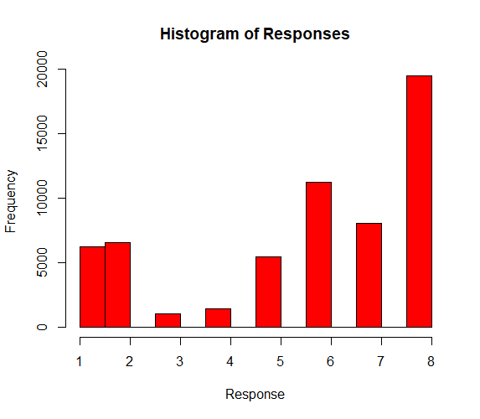
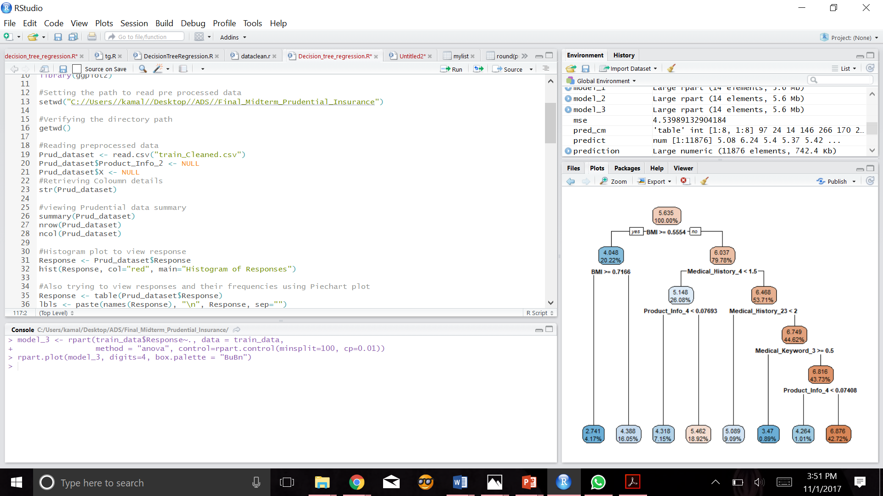
Decision Tree Regression
Decision tree: It is supervised learning method. Tree based methods empower predictive models with high accuracy, stability and ease of interpretation.
Recursive partitioning: Based on the rules applied, the main dataset is split into subsets recursively
Why Decision tree?
Decision Tree is very simple to understand and interpret the results
Useful in data exploration
It works for both numeric and categorical data
Robust and can handle big data
Basic Steps:
Installed the required packages
Loaded the libraries
Read the pre-processed data
Retrieved column details using str()
Viewed the Prudential Insurance dataset summary

Slide 12
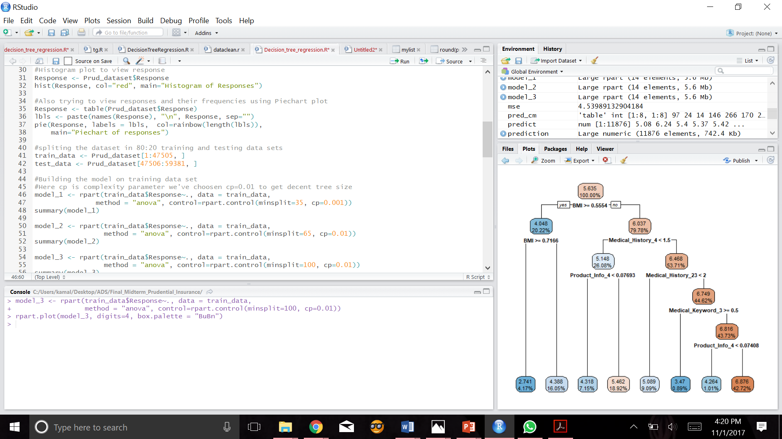
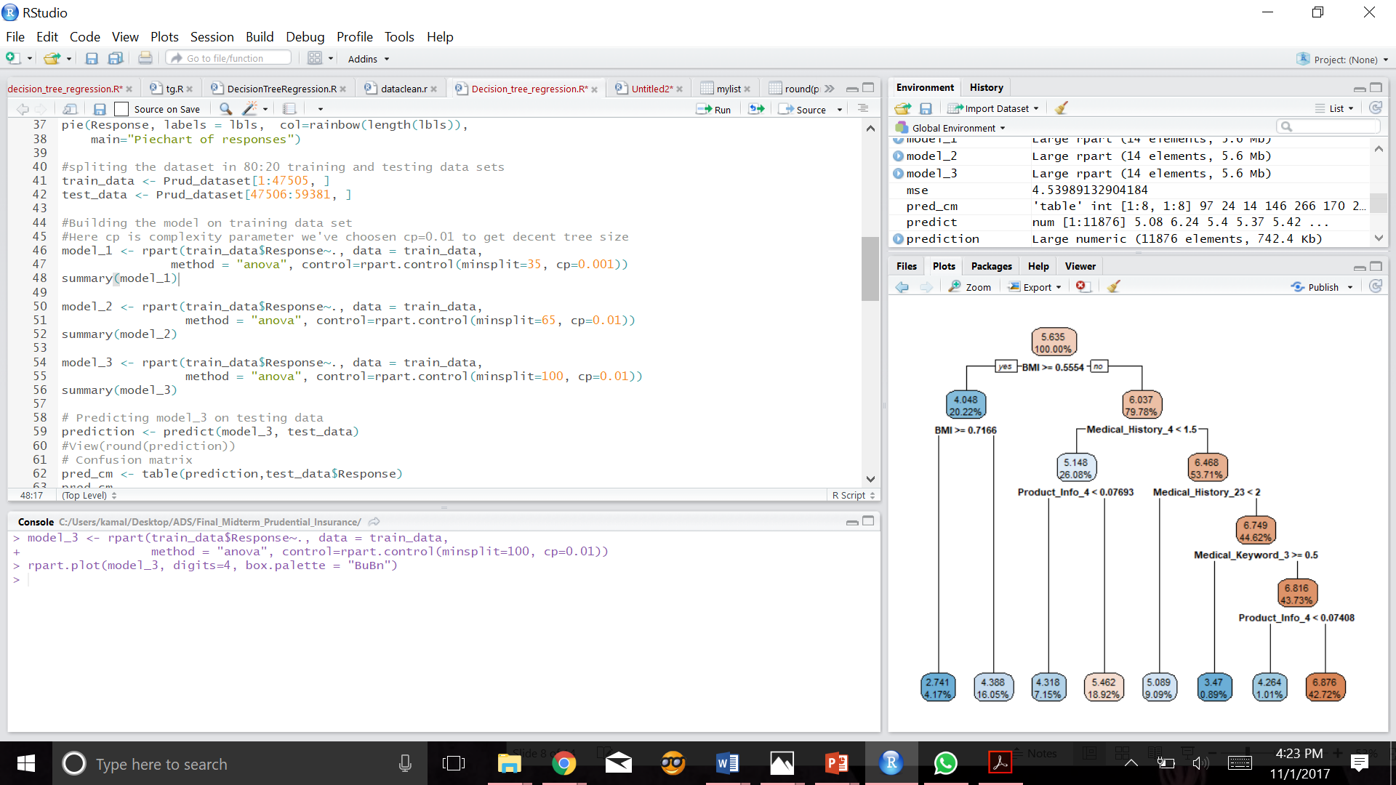
Decision Tree Regression Steps
- Splitting of training dataset in 80:20 training and testing data sets
- Building the model on training data set
- Rpart- Recursive partitioning for classification, regression
- Predicting model on to test data
- Measuring the model performance using Mean Absolute Error:
- Improved the performance:
- Rweka- Weka is a collection of machine learning algorithms for data mining tasks, containing tools for classification, regression, clustering. Package 'RWeka' contains the interface code
Package: install.packages("Rweka") Library used :library(RWeka)

Slide 13
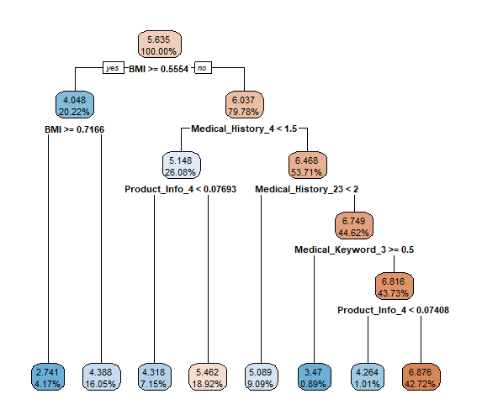
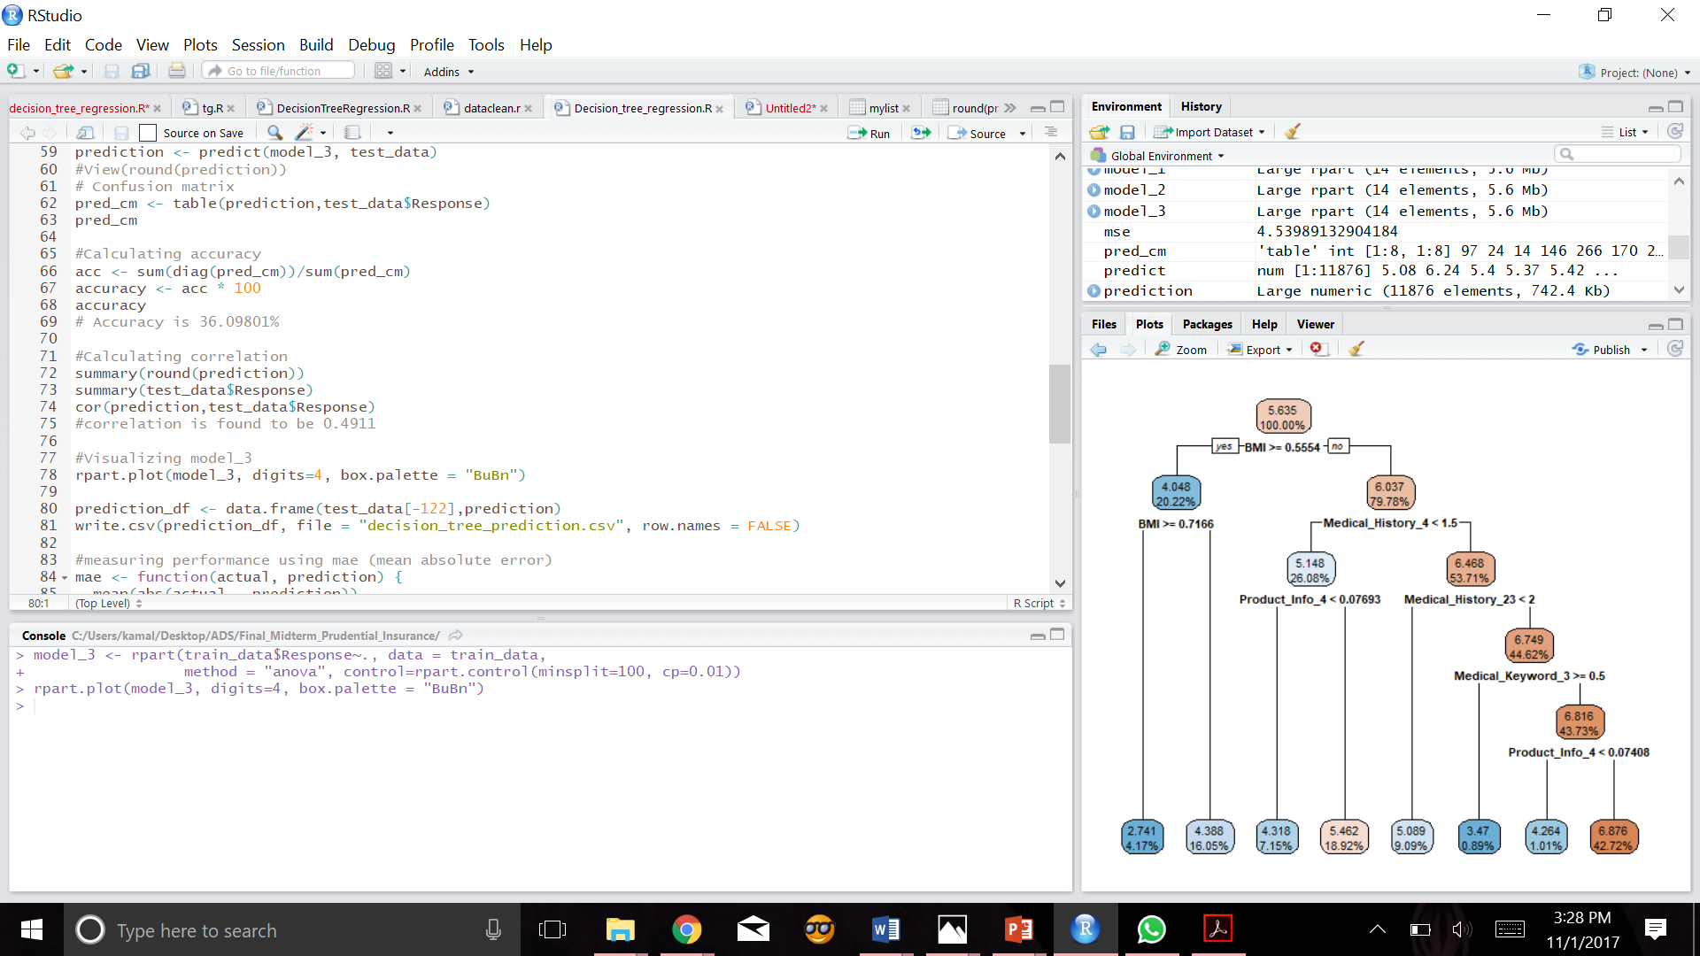
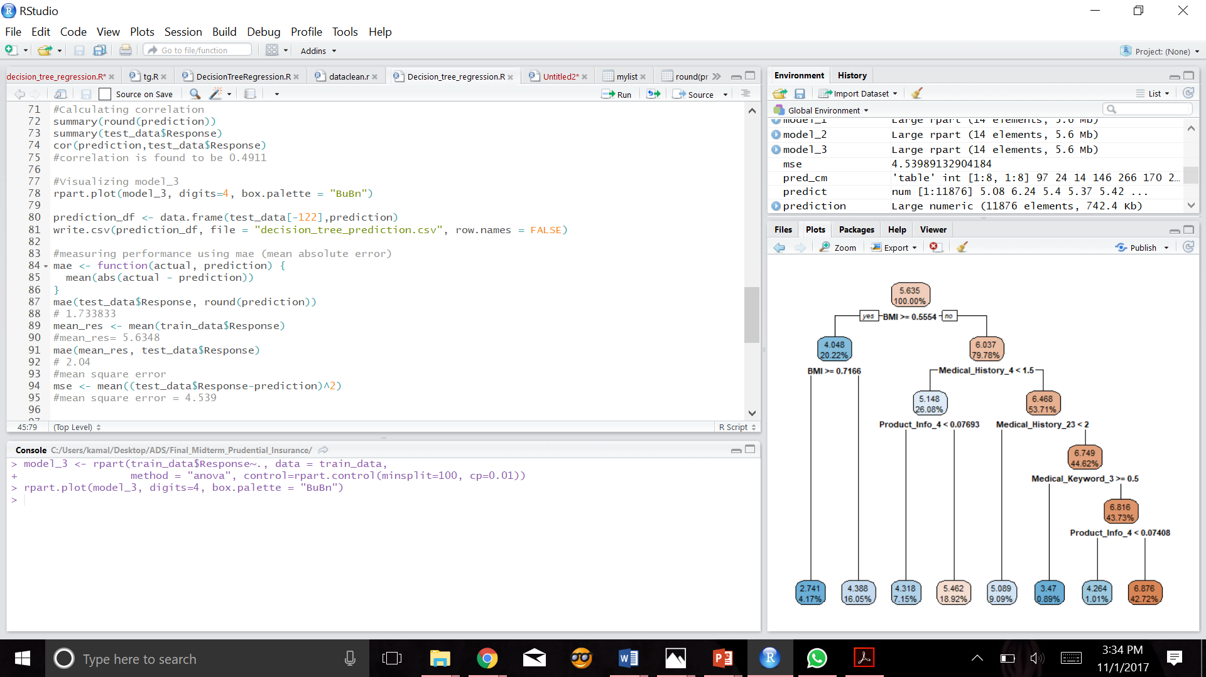
Plotting the decision tree
Here minsplit is the minimum number of observations that must exists in a node
cp is complexity parameter we've chosen cp=0.01 to get decent tree size

Slide 14
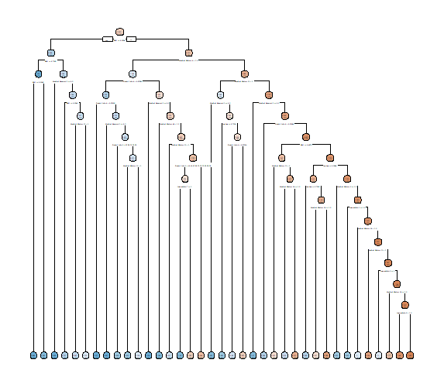
Comparisons

Slide 15
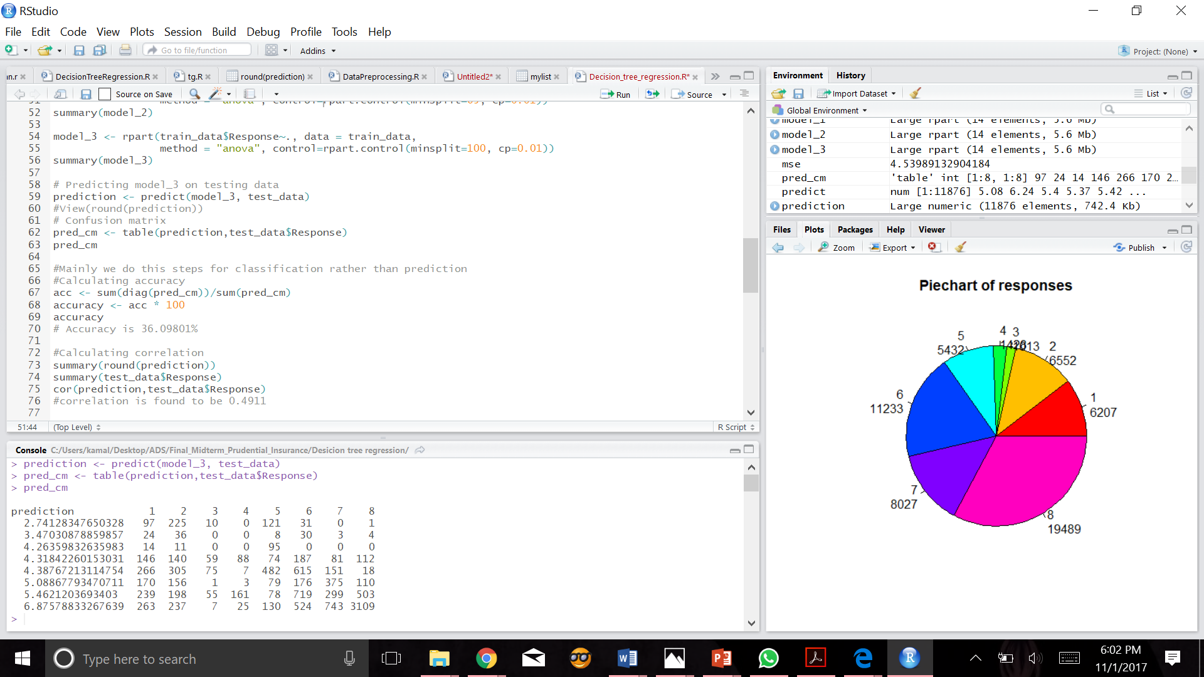
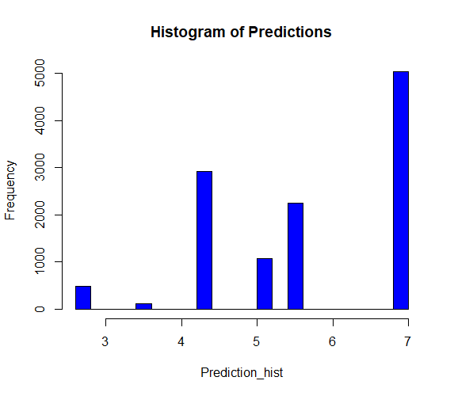
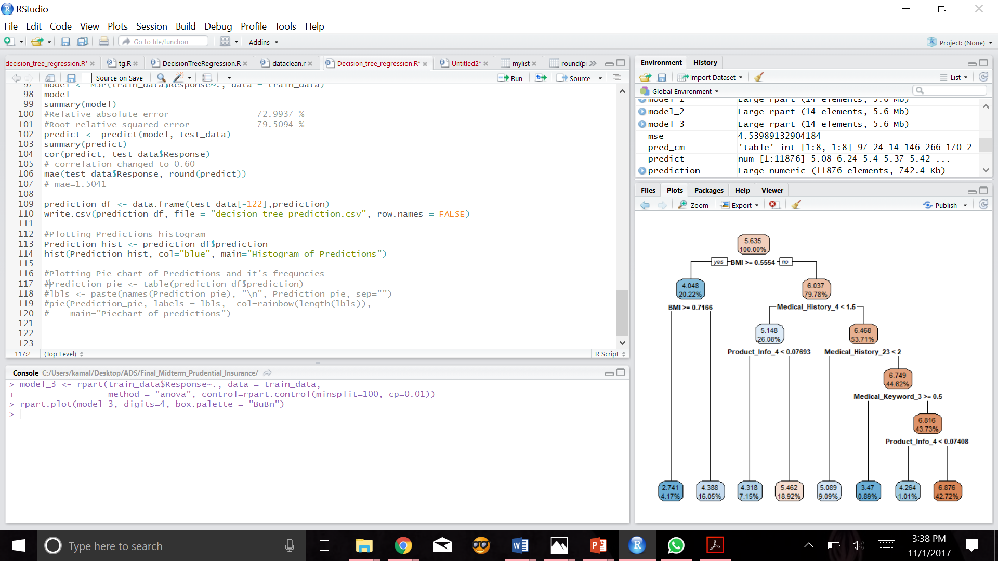
Accuracy and Correlation

